Slide 1
PORT SAN ANTONIO Impact on the Alamo Region
presented to
SOUTHWEST REGION EXECUTIVE DIRECTORS ASSOCIATION
presented by
Tim Treviño Senior Director of Operations & Strategic Partnerships
Date of Presentation
Thursday, July 27, 2017

Slide 2
At A Glance
Port San Antonio, a political subdivision of the State of Texas under Chapter 379B of the Texas Local Government Code, was born out of the Greater Kelly Development Authority, that resulted from the 1995 Base Closure and Realignment (BRAC) of Kelly AFB.
Port San Antonio has an 11-member of board directors, that is appointed by each member of the San Antonio City Council. It is operationally independent from the City.
Port San Antonio has no taxing authority.
Its annual operating budget, approximately $40 million, is derived from activities within the Port’s geographic boundaries—including leasing, property management and construction management.

Slide 3
At A Glance
While Port San Antonio does engage in some trade, the bulk of its economic activity results from its role as one of two intermodal logistics facilities in Texas.
These facilities add value and increase overall economic impact by serving as important logistical hubs, providing tenants access to runways, major highways and railways.
Texas State Comptroller analysis estimates that Port San Antonio creates more than 27,000 direct and indirect Texas jobs, contributes $5.2 Billion in output, $3 Billion to our gross domestic product, and $1.8 Billion in Disposable Income.
The Port is on a path to create 5,000 new jobs between 2015 and 2020, with a focus on those centered around the cybersecurity, defense, aerospace / aviation, manufacturing and global logistics sectors.

Slide 4
At A Glance
Third-fastest growing city in the U.S.
Among the youngest U.S. cities (median age 33).
Over 100,000 enrolled in college or university.
One of the lowest costs of living among U.S. cities.
A strategic location for trade within Texas and with Mexico—markets totaling over 130M consumers.

Slide 5
Room To Grow
Port San Antonio was created in 1995 on the site of the former Kelly Air Force Base. Its layout, location and structure differ somewhat from typical ports in our state, providing:
Convenient access to three interstate highways (IH-10, IH-35, and IH37).
1,900-acre campus.
11,500-foot runway with large aircraft capability.
350-acre rail-served site.

Slide 6
A Growing Center for Targeted Industries
The Port is home to a thriving industry cluster that includes aerospace, manufacturing, defense, cybersecurity and global logistics operations.
For almost two decades, the Port has been a vital partner to its customers by providing highly-specialized facilities and important support to ensure access to a well-prepared workforce.
The Port is currently supporting further industry growth and preparing for expansions while helping to generate over $5 billion in economic activity.

Slide 7
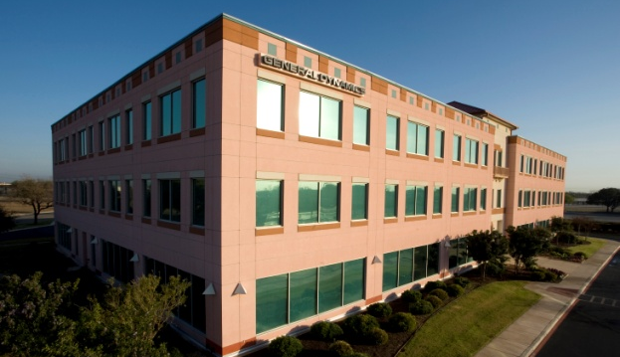
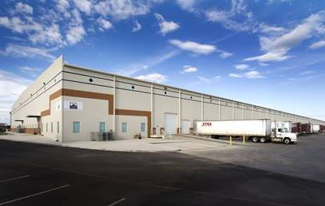
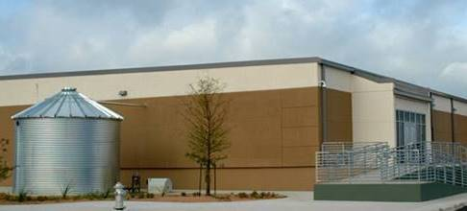
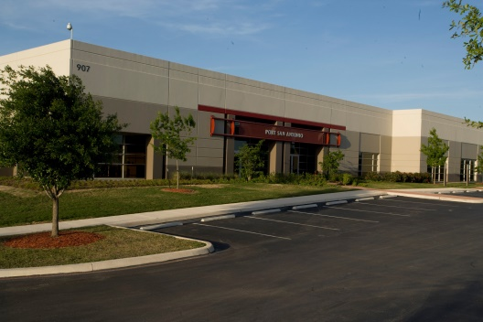
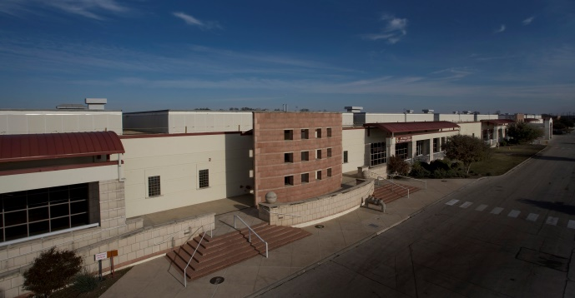
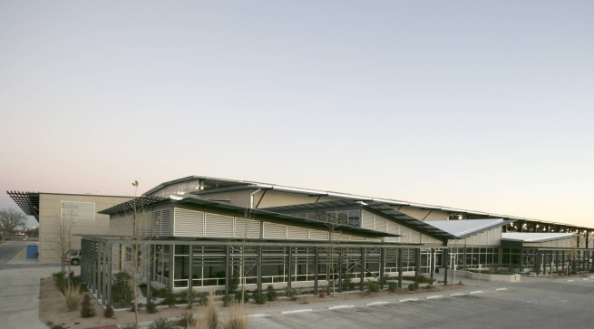
Region’s Single-Largest Industrial Platform
10 million square feet
Over 90% occupancy
Hangars | Workshops | Warehouses | Offices | Workforce Housing

Slide 8
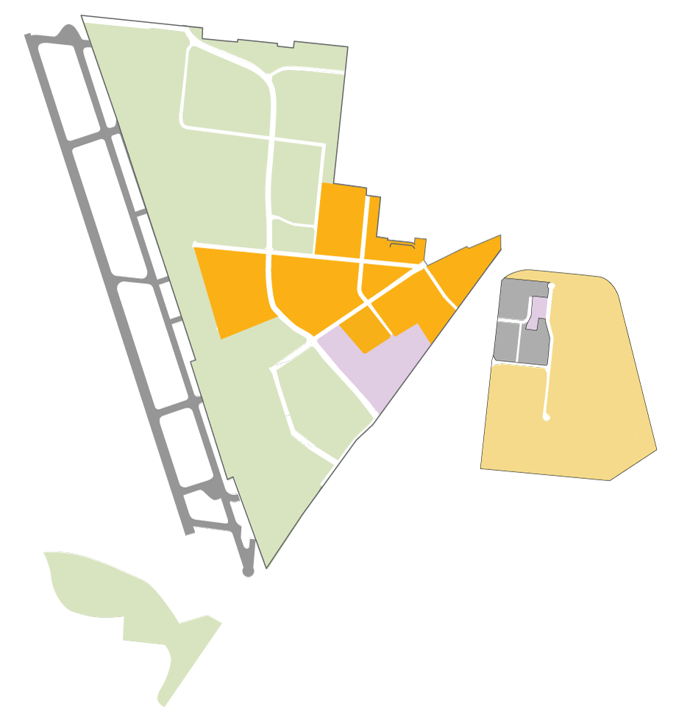
Approximately 1,900 Acres
$5.2 BILLION+
ANNUAL IMPACT
Source: Texas Comptroller’s Office, Nov. 2016
36TH ST.
GEN. MCMULLEN DR.
JOINT USE AIRFIELD
Kelly Field/FTZ
GEN. HUDNELL DR.
Mixed-Use Center
East Kelly Railport
Air Force
St. Philip’s College SW Campus
Notes:
This means growing the property STRATEGICALLY.
It means creating the MOST GOOD for the GREATEST number of people.
Very specifically... it means creating GREAT JOBS for our community TODAY... And years to come.
Today, we are home to over 70 tenant customers who DIRECTLY employ about 12,000 residents of the San Antonio region.
Port San Antonio CAN and WILL grow these numbers in the years ahead. This is a primary charge from their Board of Directors.
The Port is preparing TODAY for the hundreds of thousands of new residents expected in the next 20... 30 years.
Where will they live.?... Where will they work?
The Port is EAGER to be part of solution.
The Port is EAGER to be a platform for job growth for today’s and future generations.
The Port is EAGER to support key industry partners that can create jobs at the Port.
The Port wants to pursue jobs that provide CAREER-ORIENTED opportunities for the community.

Slide 9
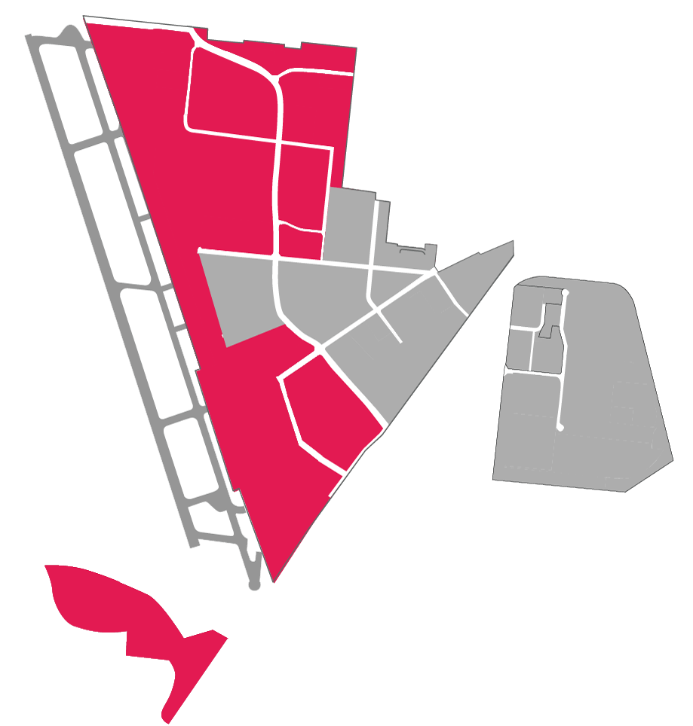
Aerospace +
Manufacturing + Logistics
3000+ Jobs
Notes:
When you look at Port San Antonio, you will see much of the property supports AEROSPACE organizations.
They conduct aircraft maintenance, repair and overhaul services.
They are, in fact, continuing the HISTORY & LEGACY of Kelly.
Unfortunately, 2-weeks ago Lockheed Martin announced they would be leaving San Antonio in 2018. They have had a presence at Port San Antonio since the 1990’s. Standardaero has retained much of their San Antonio staff.
Several customers have important roles SUPPORTING AEROSPACE.
They include XPO LOGISTICS and URS, which specialize in AEROSPACE LOGISTICS.
The Port also has SUBCONTRACTORS, like GOAEROMX, which provides AVIONICS SERVICES.
The Port also supports NON-AEROSPACE LOGISTICS OPERATIONS...
They include FORWARD AIR, TRIPLE-S STEEL and HEB.
They serve regional industries, such as construction and retail.

Slide 10
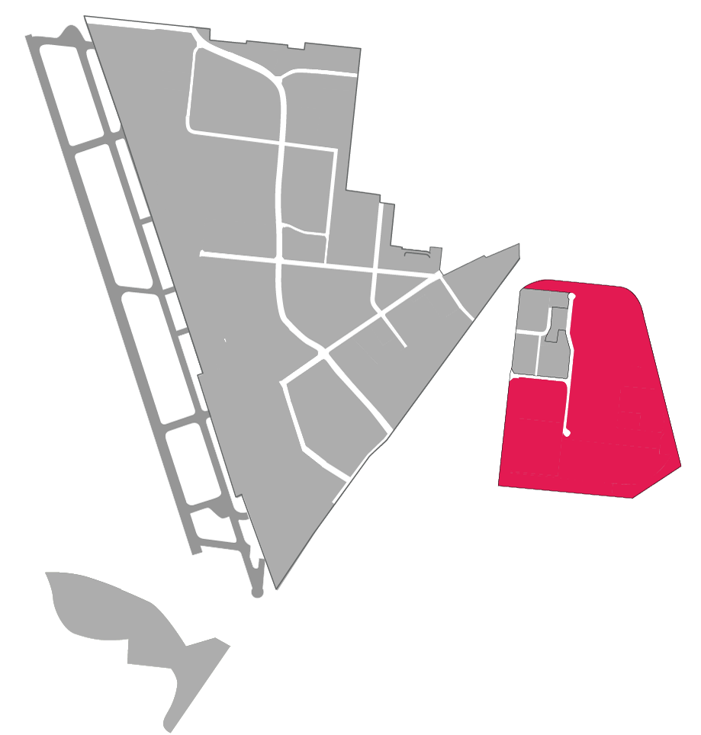
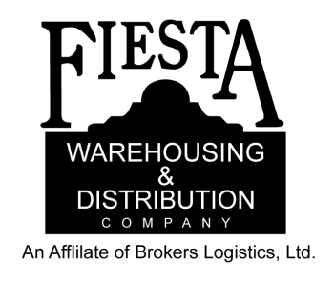
Rail Logistics +
Manufacturing
300+ Jobs
Notes:
The East Kelly Railport is growing FAST.
This is a relatively new center for LOGISTICS and development ready for rail served advanced MANUFACTURING.
Firms like XPO Logistics have additional operations here.
BERGSTROM has been here since 2012. This company builds air conditioners for semi-trucks for the U.S. and Latin American markets.
GBW has a significant operation that repairs railcars.
And firms like FIESTA, OPTECH and CIG provide logistics support to key area industries.
In fact, the Railport supports many jobs BEYOND the Port San Antonio property.
These include:
truck drivers
energy workers and
those employed in construction, retail and manufacturing

Slide 11
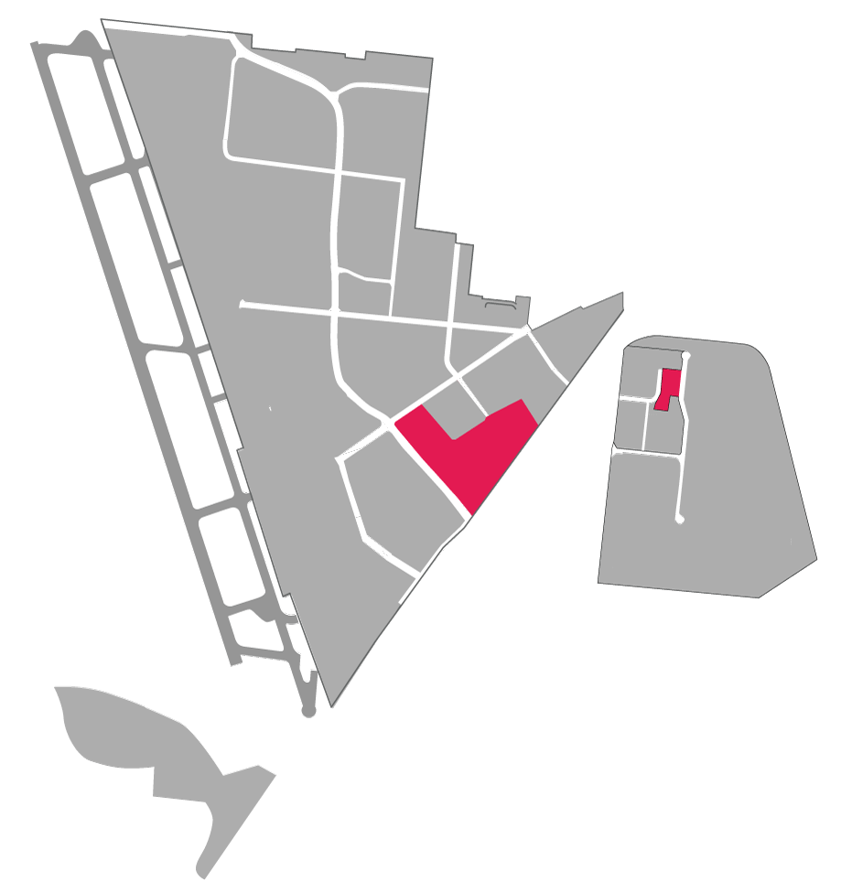
Air Force / DoD
20+ Organizations
6,000 jobs
Notes:
The AIR FORCE has a huge presence on site.
This is another example of capturing opportunities in a changing environment.
The 2005 BRAC brought thousands of personnel to our region.
As a result, the Port partnered with the Air Force and managed over $60 MILLION IN UPGRADES TO A COMPLEX OF 5 BUILDINGS.
That development, today known as Lackland Annex, is home to several headquarters... and thousands of professionals.
They include:
The Cyber Command
The Air Force Civil Engineer Center
The Air Force Medical Operations Agency
The Air Force Cryptologics Center
...among others.
Most of these workers have high-paying jobs, as
Cyber security experts
Architects
Environmental engineers
Logistics experts
Public affairs specialists and
Attorneys

Slide 12
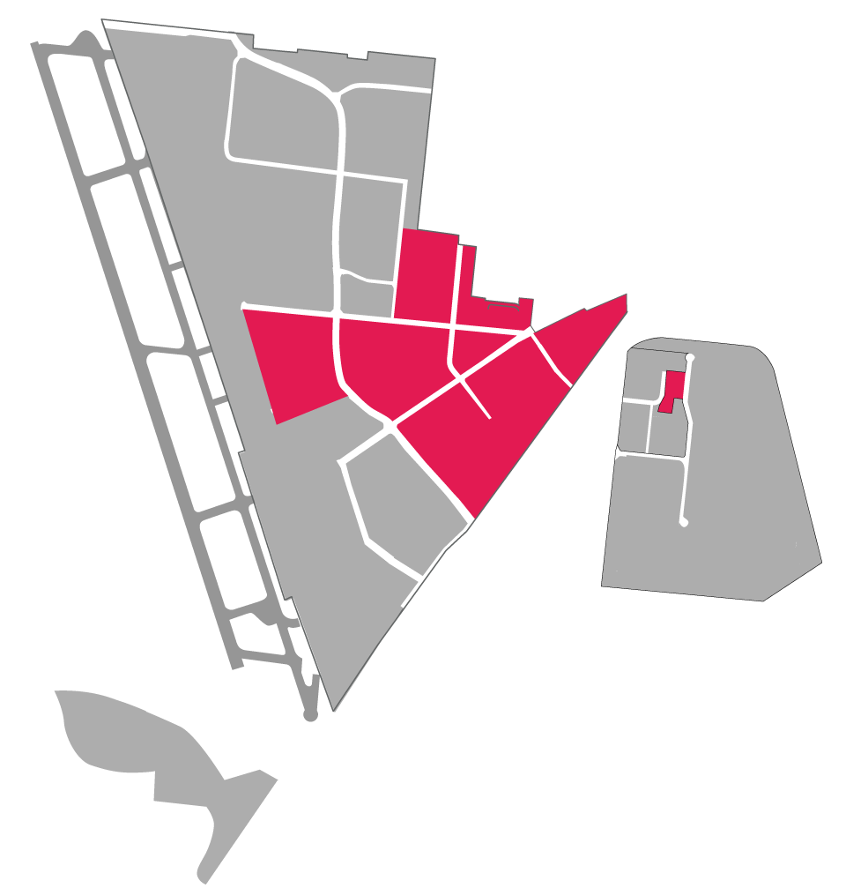
Cyber-related
1,000+ jobs
Notes:
.

Slide 13
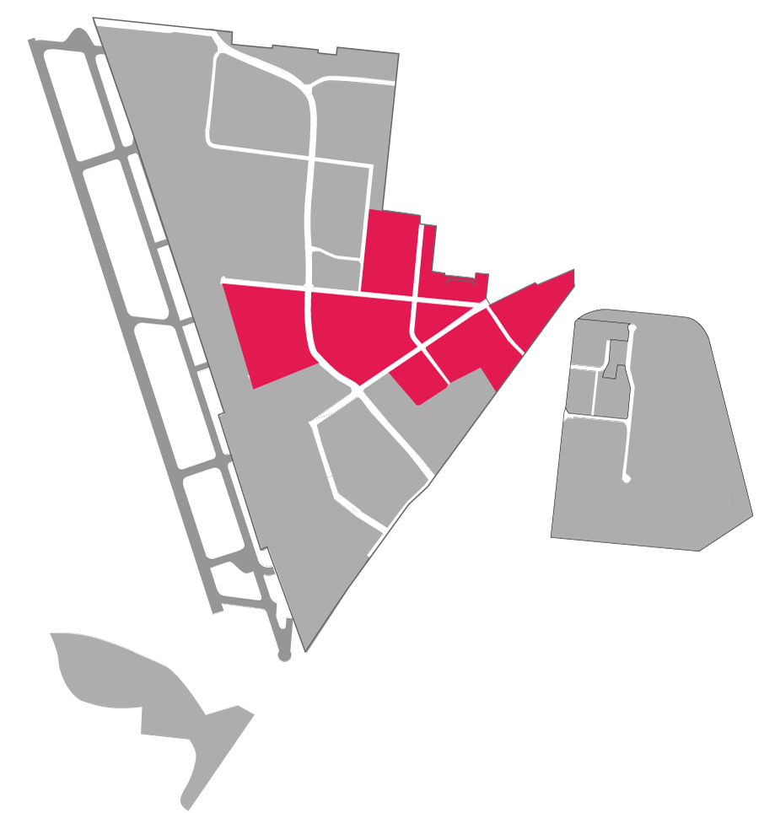
Mixed-Use Office + Workforce Housing
1,500 jobs
Notes:
The Port’s MIXED-USE PROPERTIES include historic buildings AND new construction.
Office space at the PORT supports contractors like BOOZ ALLEN HAMILTON and GENERAL DYNAMICS; whose customers are next door at LACKLAND ANNEX.
XEROX has over 1,000 employees within its facility and provides business support to government and private sector customers.
Services by Xerox include child support disbursements and credit card application processing.

Slide 14
70+ Employers • Aerospace • Cybersecurity • Logistics • Manufacturing • Defense
Notes:
We’re home to over 70 companies / 12,000 workers in our target industries and others.
These are good jobs.
Key industries, particularly aerospace and cyber, pay well above the area median wage.
75 percent of workers live outside council districts 4 and 5.

Slide 15
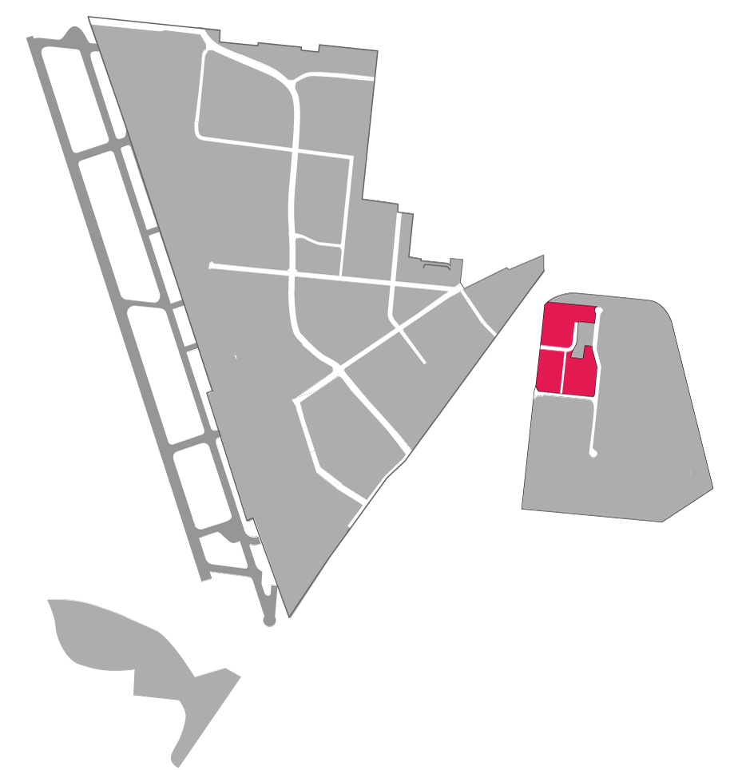
Strategic Workforce Partner
Aerospace
Advanced Manufacturing
Information Technology
Heavy Equipment
Just-In-Time Training
Notes:
Of particular importance to the Port’s economic development strategy are the Alamo Academies housed at the Port’s Southwest Campus.
Created in 2001, the dual-credit programs prepare high school students throughout the community—at no cost to them or their families—for careers in aerospace, cybersecurity, advanced manufacturing and other key area sectors.
Upon graduation from high school, Academies’ students are well on their way to associate’s degrees and certificates that are the keys to entering good paying careers with several industries based at the Port.

Slide 16
Advancing Mission by Balancing Priorities
FISCAL
RESPONSIBILITY
Maintain operational self-sufficiency and financial viability
RESPONSIBILITY TO COMMUNITY
Promote job creation by supporting growth of employers at Port

Slide 17
Strategic Redevelopment = Job Creation
1. Retain Existing Customers
2. Expand Existing Customers
3. Attract New Customers
$ 100 Million +
in recent + ongoing + upcoming projects

Slide 18
Utilities Improvements
Notes:
Funding:
An estimated $20 million has been invested in the area.
One specific example is the recent Defense Economic Adjustment Assistance Grant secured by AACOG, from the State of Texas, for San Antonio Water Systems to provide secondary sources of water to the Lackland Annex and Security Hill area around the Port.

Slide 19
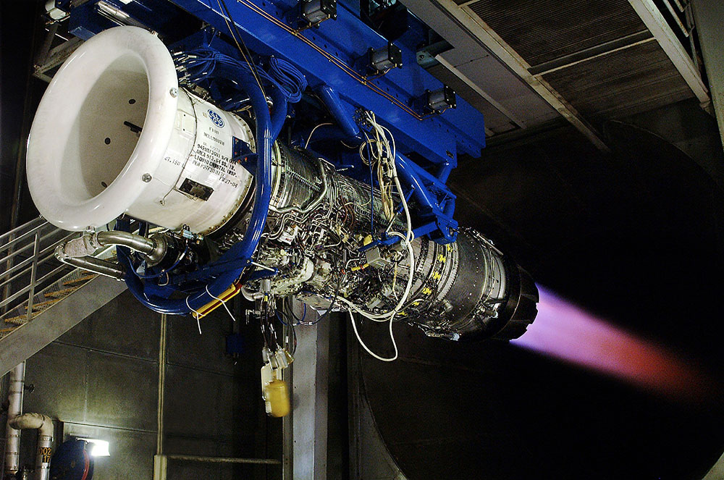
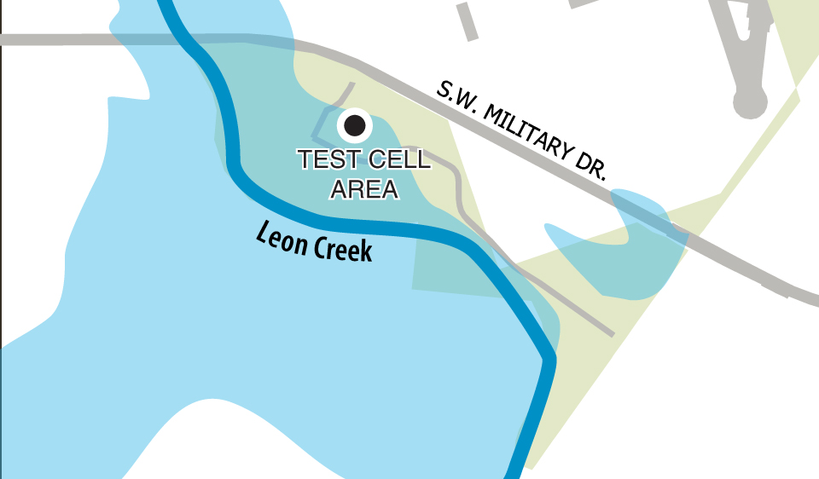
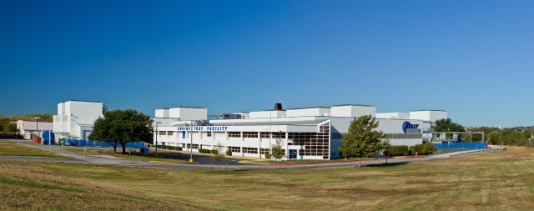
Floodplain
Engine Test Cell Protection
Notes:
Engine test cell flood-proofing
What it does: Interim fix to prevent floodwaters from nearby Leon Creek to enter $250-million aircraft engine testing facility.
Funding: $4 million (Port, City of San Antonio, Economic Development Administration)
Long term solution is $28-million levee system through Army Corps of Engineers

Slide 20
Recap - Port San Antonio
The 1,900-acre site features an industrial airport, railport and mixed-use development.
Today, Port San Antonio is home to over 70 private and public sector organizations which employ approximately 12,000 workers in aerospace, cybersecurity, military, logistics, manufacturing and other key industries.
Over 360 acres of build-to-suit sites with access to Kelly Field, the Port’s industrial airport featuring the region’s longest runway.

Slide 21
Recap - Port San Antonio
Over 150 acres (61 hectares) for build-to-suit rail-served sites at East Kelly Railport, with access to Union Pacific and BNSF Railway trains—supporting logistics and manufacturing operations.
Access to a well-qualified workforce thanks to partnerships with area colleges and universities.
A platform for international trade, thanks to the foreign-trade zone designation (FTZ #80-10) of the entire property and on-site U.S. Customs.

Slide 22
Conclusion
Port San Antonio’s integrated access to trade and services from air, road and rail makes it unique among Texas’ 29 ports. Because of its role as an intermodal facility, the port’s actual trade totals are less than traditional ports.
Its contributions to the Texas economy are notable: an estimated 27,000 JOBS and $5.2 BILLION in economic activity in 2015.
By revitalizing and expanding a former air base, Port San Antonio has leveraged its access and infrastructure to attract new avenues of trade, jobs and economic contributions to the region.

Slide 23
THANK YOU
Tim Treviño
Sr. Director of Operations & Strategic Partnerships
EM: ttrevino@aacog.com
D: (210) 832-5089

