Slide 1
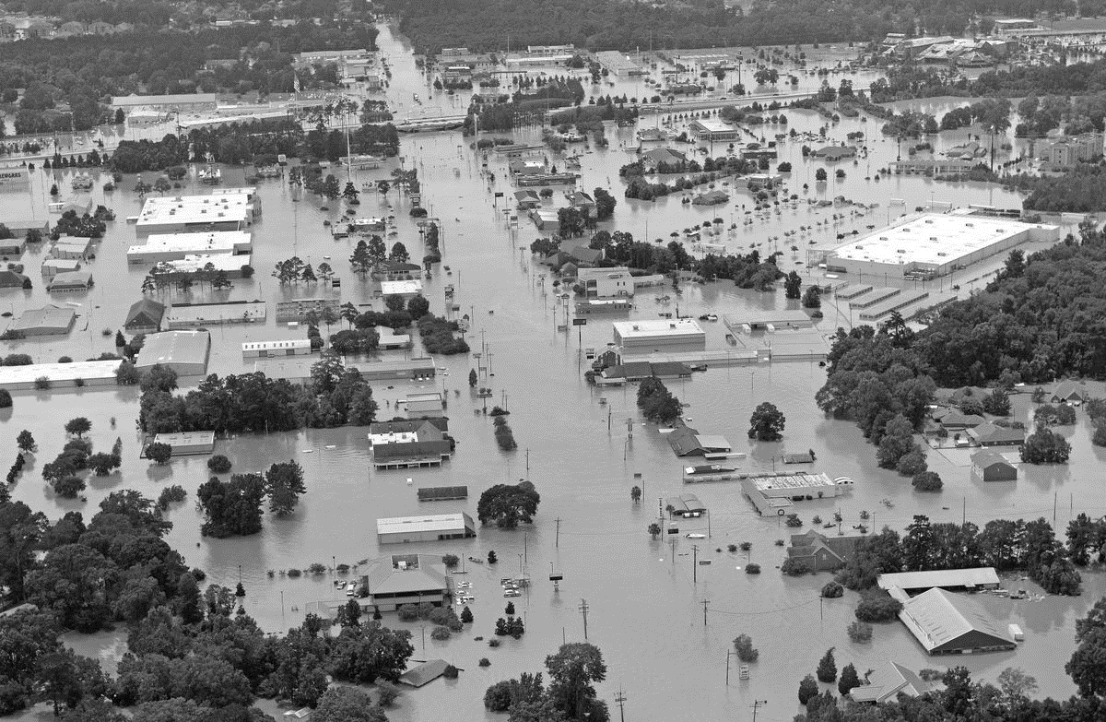
SWREDA CONFERENCE
Capital region planning commission
Baton rouge, la july 2017

Slide 2
Capital Region Planning Commission
CRPC is comprised of 11 parishes and 44 municipalities. Parishes include:
Pointe Coupee, West Feliciana, East Feliciana, Iberville, West Baton Rouge, East Baton Rouge, Livingston, Ascension, St Helena, Tangipahoa, Washington

Slide 3
Past experiences with disasters
The greater Baton Rouge area in the past was prepared to receive populations of displaced residents from coastal Louisiana.
Post Katrina/Rita (2005) Baton Rouge saw an immediate spike in population.
Issues: Traffic, school over crowding, housing shortages and cost increases
“We'll never be the Baton Rouge we were prior to Katrina," Mayor Melvin "Kip" Holden says.
Evacuees "changed the landscape of this region forever," Baton Rouge police Sgt. Don Kelly says. "None of us really knows what the long-term impact will be.“
Post-Katrina Baton Rouge struggles with its identity Updated 2/22/2007By Kevin Johnson, USA TODAY
Notes:
Now growth is to the north, east and south of Baton Rouge which contributes to the worsening traffic problems in the region.

Slide 4
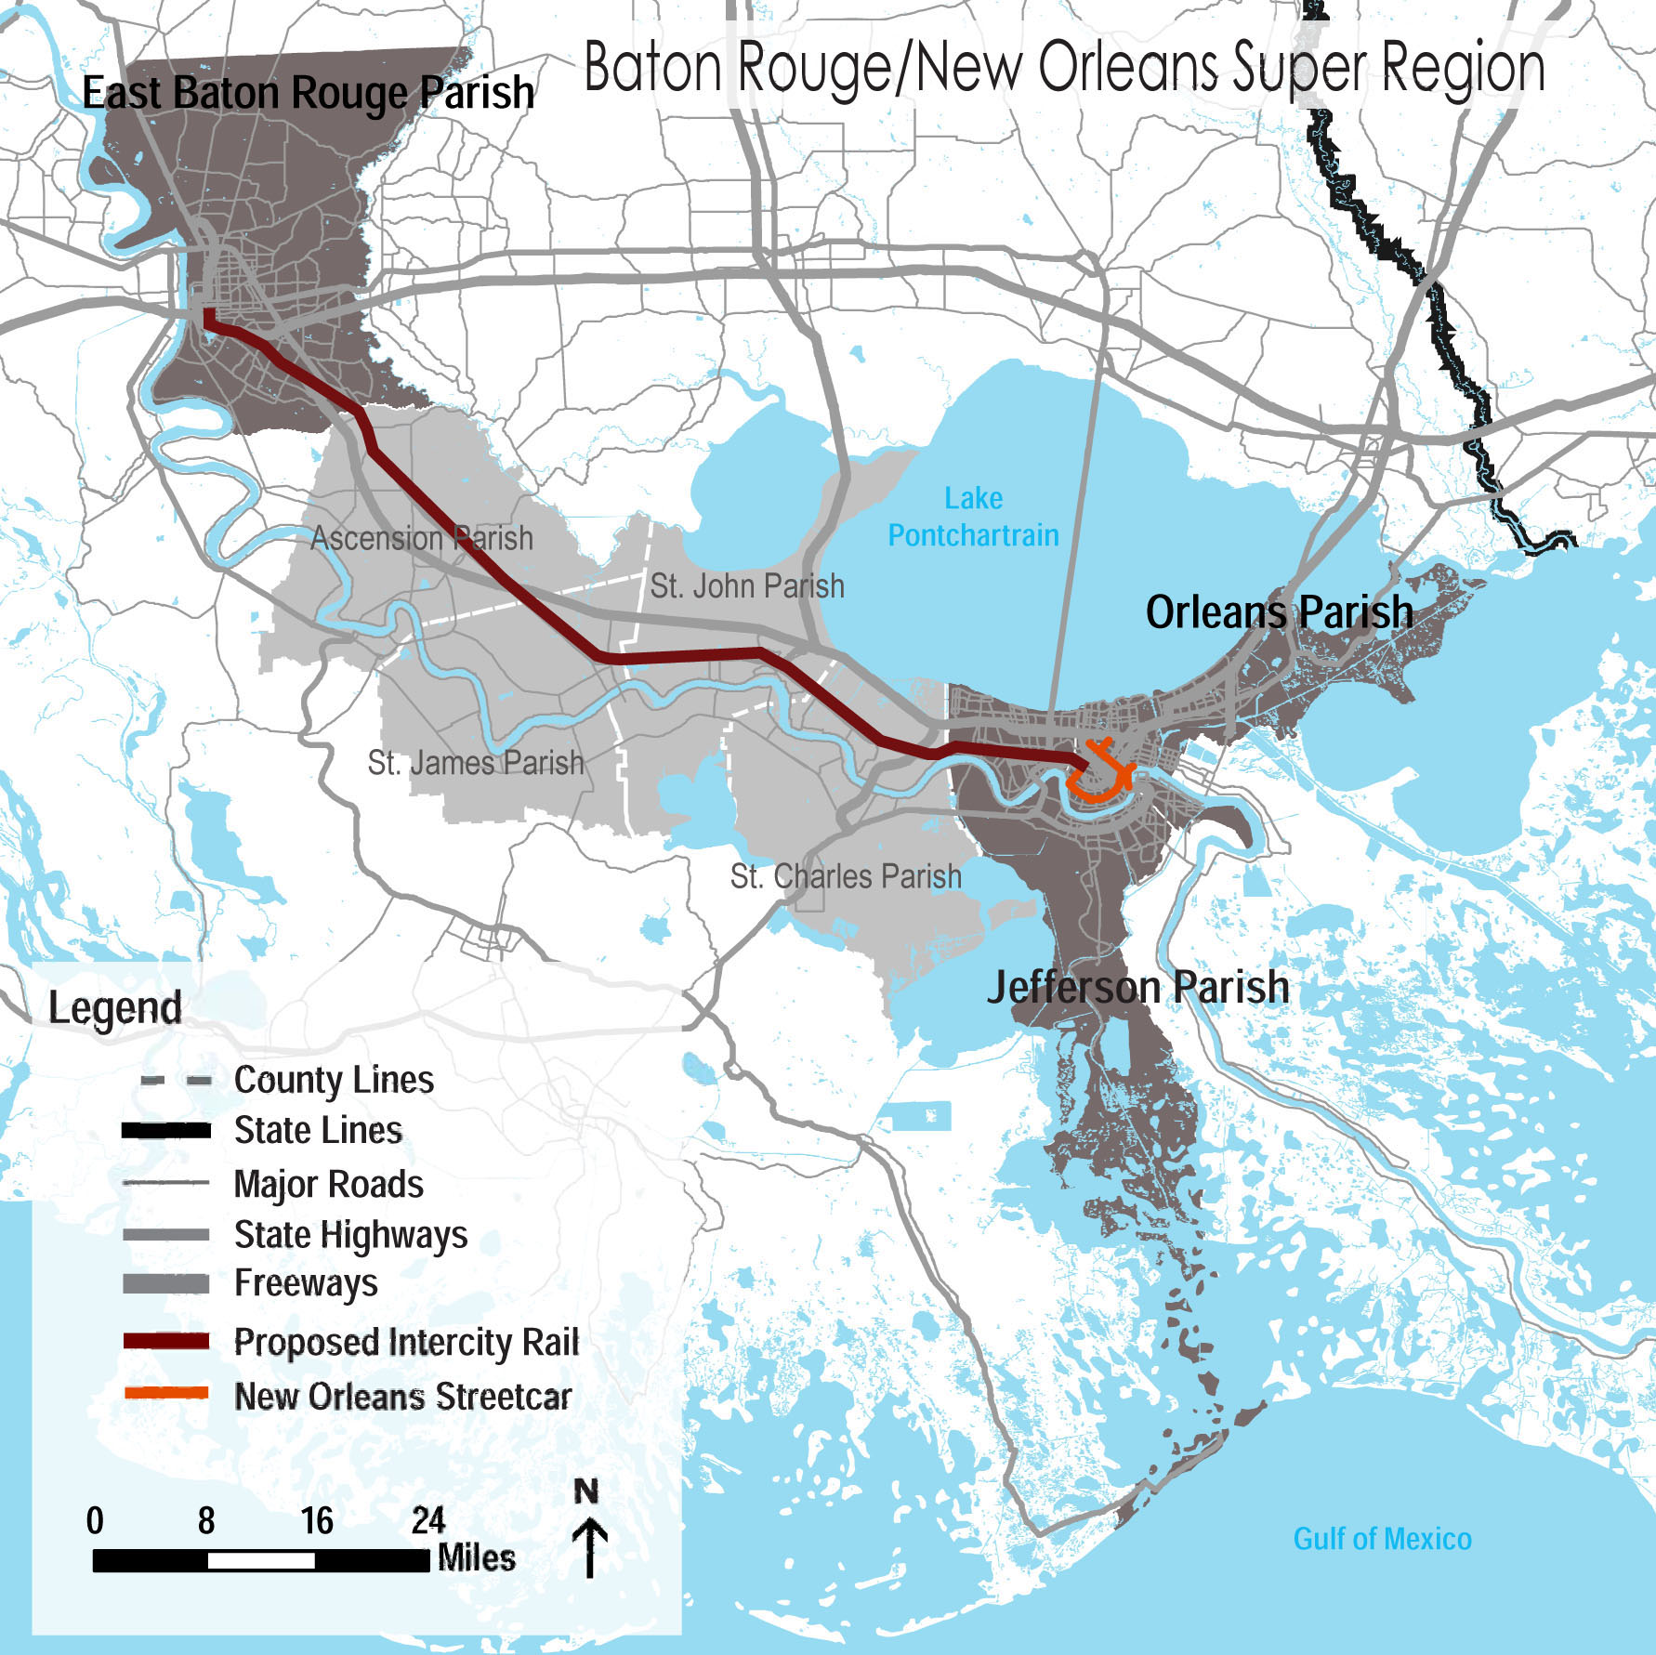
Disasters led to ‘Super Region’
“… New Orleans and Baton Rouge in particular shared so many existing businesses and commercial relationships before the storms, as well as the great river ports. Those ties were given immensely more salience in the post-Katrina era.”
Lanny Keller: Katrina effect in Baton Rouge went beyond population growth, brought unity to 'super region’” The Advocate, 9/4/15.
http://www.reconnectingamerica.org
Notes:
Positive side of the displacement of new orleanians to the baton rouge area was the development of stronger ties between New Orleans and Baton Rouge as well as a greater understanding about the need to strengthen the regional partnerships.
Three leading business-based organizations - Greater New Orleans Inc., the Baton Rouge Area Chamber and One Acadiana share missions focused on economic and community development

Slide 5
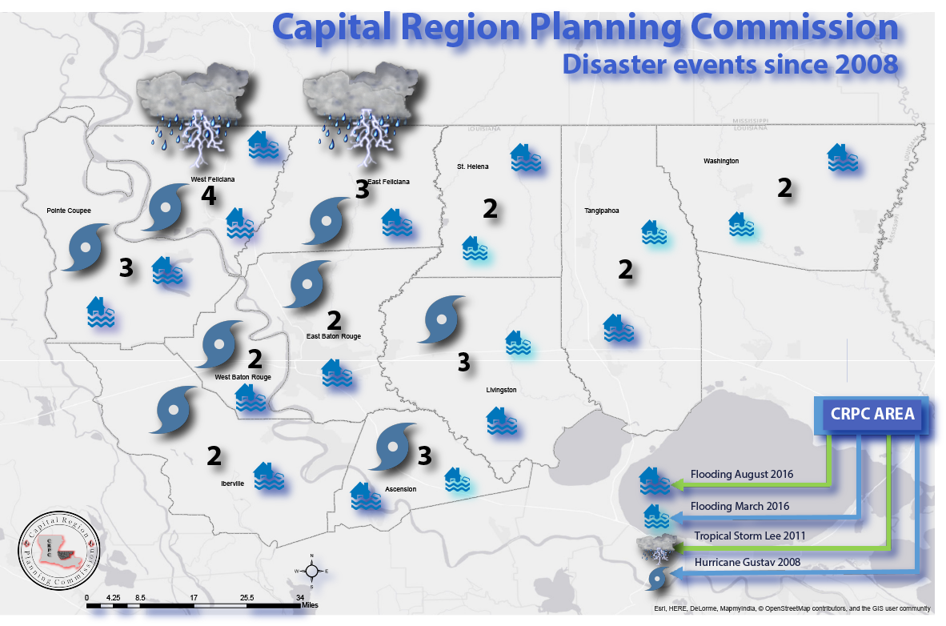

Slide 6
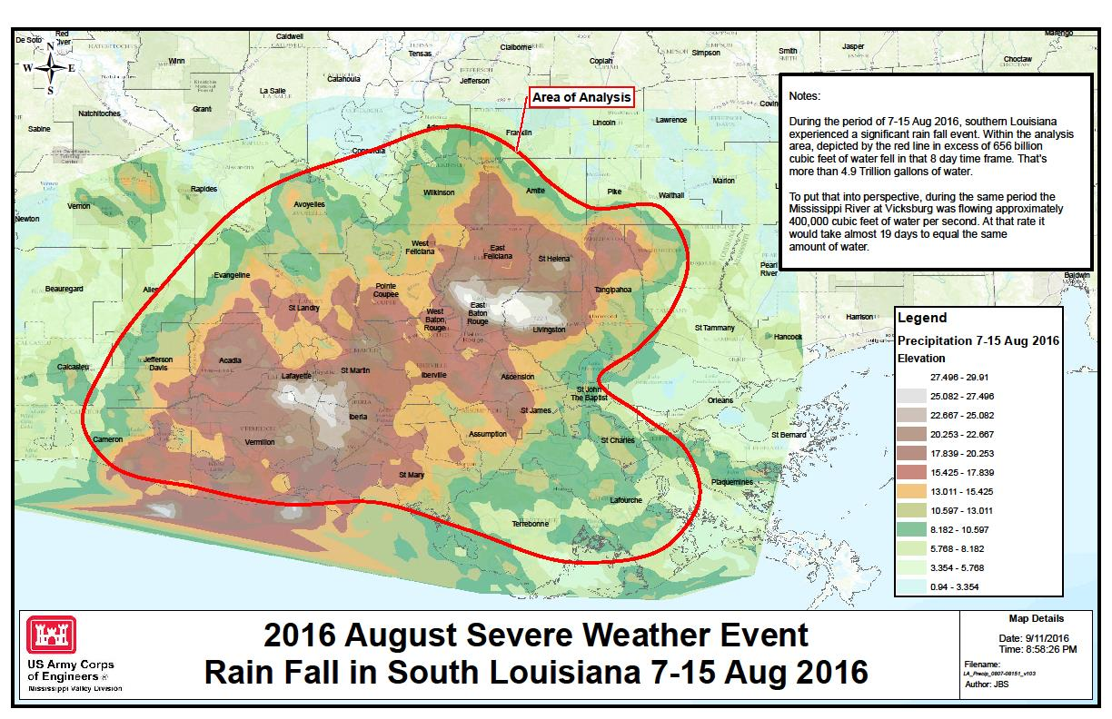
How was this event different
“We’ve been through Hurricane Gustav, Katrina, Isaac and Rita, but this without a doubt is the roughest we’ve ever had in this parish,” said Livingston Parish Sheriff Jason Ard.
'Like nothing we've ever seen': Flood danger is not over in Louisiana.” LA Times, 8/17/2016
Notes:
Weather event that could happen anywhere. Not a named storm, or hurricane this was a rainfall event – possibly a 1,000 year storm event.
The maximum rainfall total for this event was 31.39 inches in Watson, Louisiana according to weather.com, other places saw rainfalls in excess of 2 feet.

Slide 7
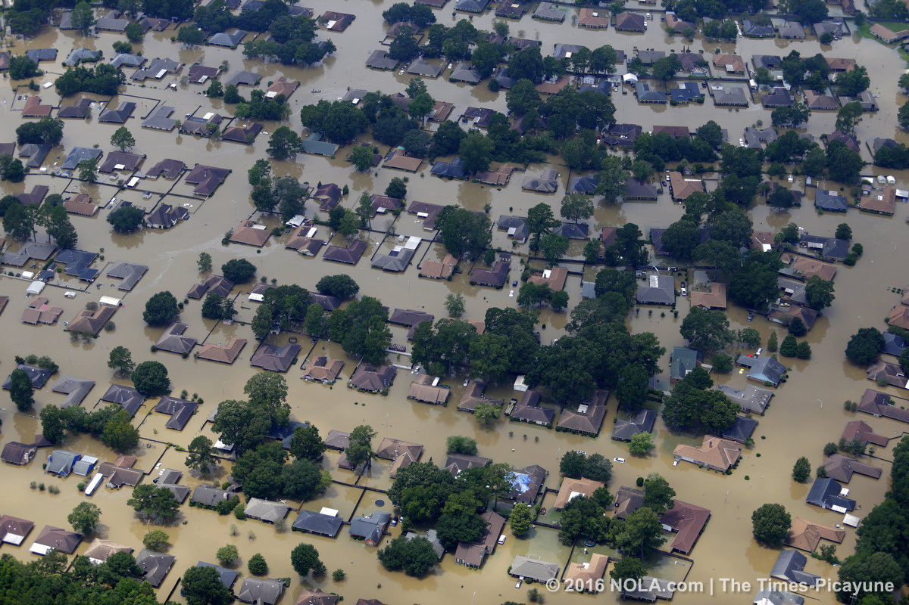
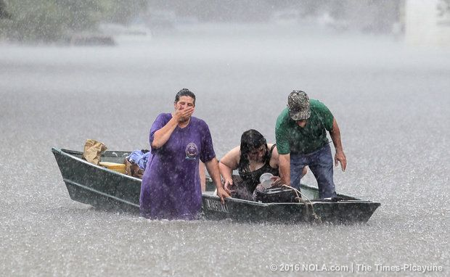
2016 NOLA.com/The Times-Picayune

Slide 8
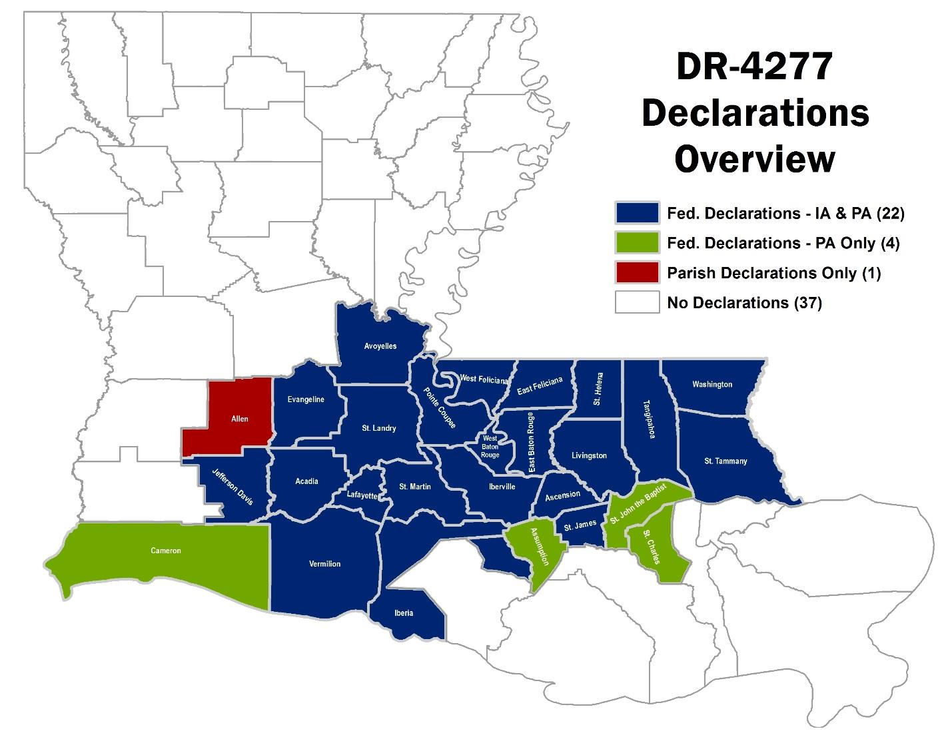
State level impacts – declarations
MARCH 2016
AUGUST 2016
Allocations, Waivers and Alternative Requirements for Grantees Receiving Community Development Block Grant Disaster Recovery Funds in Response to Disasters Occurring in 2016, The Continuing Appropriations Act, 2017 (Public Law 114-223) Federal Register Docket No. FR-5989-N-01
Notes:
Two back to back disasters 56 of 64 parishes received disaster declarations
Focusing more on the DR 4277 August flooding event which dropped 7 trillion gallons of water
1,000 year flood event
Effected over 91,000 households and claimed 13 lives
Interstate 10 and 12 were closed for several days with I-10 being closed for nearly a week due to flooding
In my region 4 parishes were decared disasters in both storms: Livingston, Ascension, Tangipahoa, WA

Slide 9
State level impacts - housing
113,312 households damaged across both disasters
Of these 84,842 owner occupied and 28,470 renters
81% of household reported damage (91,628) were caused by August flood
Allocations, Waivers and Alternative Requirements for Grantees Receiving Community Development Block Grant Disaster Recovery Funds in Response to Disasters Occurring in 2016, The Continuing Appropriations Act, 2017 (Public Law 114-223) Federal Register Docket No. FR-5989-N-01
Notes:
Aug. flood was more concentrated in higher density metro areas whereas the march flood event was more concentrated in rural areas
In the august flood particularly in the capital region flooding occurred in areas of higher poverty areas/concentrations. Specific outreach efforts are needed to reach these residents who may still be displaced

Slide 10
State level impacts – no flood insurance
72 percent, or 61,069, owner-occupied households reported no flood insurance
12,921 impacted renter households were located outside of flood zone
at least 31 percent (26,783 households) of the owner-occupied households has a member that is 62 or older
Allocations, Waivers and Alternative Requirements for Grantees Receiving Community Development Block Grant Disaster Recovery Funds in Response to Disasters Occurring in 2016, The Continuing Appropriations Act, 2017 (Public Law 114-223) Federal Register Docket No. FR-5989-N-01
Notes:
As such, while this may not inherently indicate exacerbated need for the renter population itself, it may indicate an enhanced need for landlords who may not have carried flood insurance. this Represents more than 45 percent of the total affected renter population

Slide 11
State level impacts - Economic
Approximately 6,000 businesses flooded
22,000 businesses referred to SBA for recovery assistance
A disruption of 14 % of the workforce occurred at the peak of the flooding event
Total of $1.4 billion in inventory damaged by DR-4277 flooding
Agricultural losses of over $110 million
Allocations, Waivers and Alternative Requirements for Grantees Receiving Community Development Block Grant Disaster Recovery Funds in Response to Disasters Occurring in 2016, The Continuing Appropriations Act, 2017 (Public Law 114-223) Federal Register Docket No. FR-5989-N-01

Slide 12
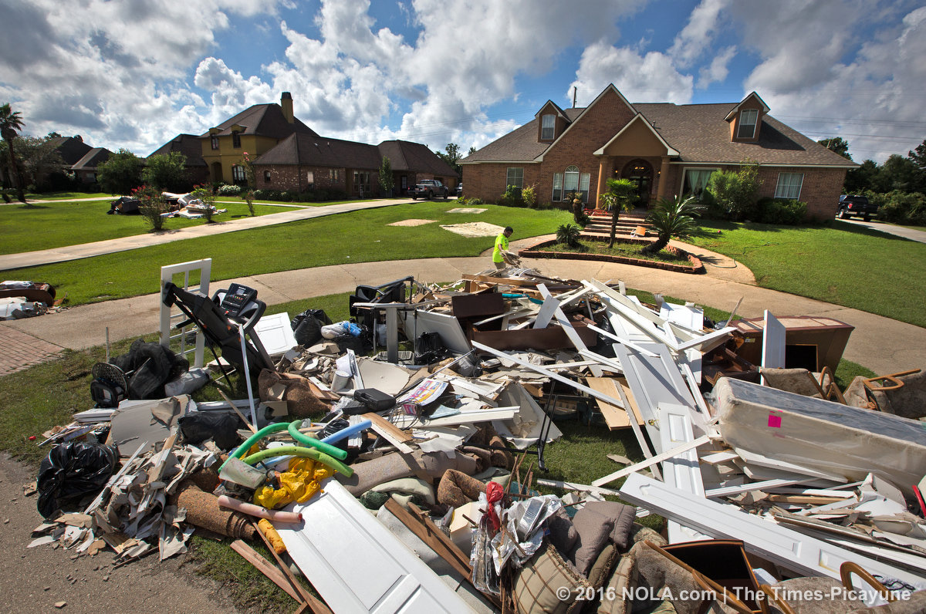
Regional housing impacts
In the 9-parish Baton Rouge Area Chamber geography (approx. 1,000 square miles):
359,619 Baton Rouge MSA residents live in areas identified flooded.
The estimated total value of those homes located in areas identified as flooded is $30.4 billion.
60.8% of the homes in flood areas were owner-occupied, 28.5% were renters; 8.1% were vacant.

Slide 13
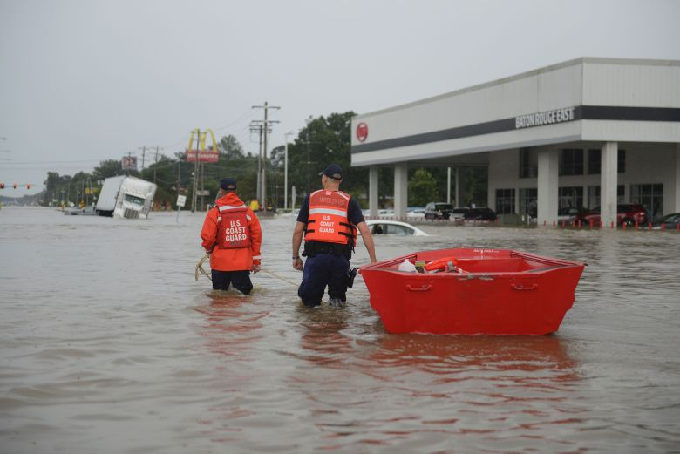
CRPC regional impacts
Across the 11-parish CRPC region 117,593 applications were made for FEMA Individual Assistance
34.8% of businesses in the Capital Region employ 32.8% of area workers.
60 % of businesses in Livingston, 19% in Ascension and 15 % in East Baton Rouge experienced flooding.
Notes:
Over the past 8 years, there have been at least five storm and flood-related disasters that have impacted the region’s communities. Ascension, Livingston, St. Helena, Tangipahoa, and Washington Parishes were effected by two seemingly back-to-back flood disaster declarations (DR-4063-LA and DR-4277-LA) in 2016, alone
The Baton Rouge Area Chamber (BRAC) analyzed residential and business flood impacts (DR-4277-LA) for a nine-parish area: Ascension, East Baton Rouge, East Feliciana, Iberville, Livingston, Pointe Coupee, St. Helena, West Baton Rouge and West Feliciana.

Slide 14
How did CRPC address resilience in CEDS
2014 CEDS updated with new resilience requirements
Goal: Work to improve and participate in regional hazard mitigation and emergency preparedness plans and coordinating functions for local and regional economic recovery support.
Build regional and local capacity to respond to natural disasters, strengthen land use and transportation planning
Coordinate educational efforts and training with local development districts and other partners in resiliency

Slide 15
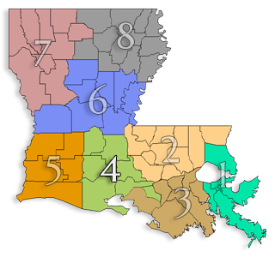
Regional resiliency in practice
Regional leaders who cross governmental and functional boundaries
Partnered with Acadiana PC to bring local issues to FEMA and State
Assisted in the development and hosting of a Resiliency Symposium – partnership with state and federal agencies
Coordinated with SCPDC to bring recovery-related RLF to the region
NADO: Planning for a More Resilient Future: A Guide to Regional Approaches
Notes:
Regional leaders who cross governmental and functional boundaries
Partnered with Acadiana PC to bring local issues to FEMA and OCD
Assisted in the development and hosting of the Resiliency Symposium – OCD/FEMA
Strong networks and deep knowledge of federal funding opportunities
Arranged tours with federal partners to meet with community leaders, economic leaders and elected officials to express recovery needs.
RSF -1 team – how we were able to leverage opportunities for local communities

Slide 16
Regional resiliency in practice
Strong networks and deep knowledge of federal funding opportunities
Arranged tours with federal partners to meet with community leaders, economic leaders and elected officials to express recovery needs.
Coordinators and Managers of external funding streams
Worked with FEMA - CPCB prioritize planning efforts in region to leverage opportunities for local communities.
EPA building blocks on green infrastructure – Denham Springs
National Renewable Energy Lab – Baker
NADO: Planning for a More Resilient Future: A Guide to Regional Approaches

Slide 17
Regional resiliency in practice
As Planners
Transit planning Disaster data mapping General community and land use planning Regional Disaster Recovery Managers
As communicators
Trusted agents in communities and can leverage existing relationships. Denham Springs and Baker recovery planning efforts.
NADO: Planning for a More Resilient Future: A Guide to Regional Approaches

Slide 18
Regional resiliency in practice
As Networkers
Acadiana – CRPC partnership
Worked with Livingston Econ. Dev. Council to identify business recovery needs - led to EDA funding
As Conveners
Watershed planning
NADO: Planning for a More Resilient Future: A Guide to Regional Approaches
Notes:
By being at the table with FEMA and the state as discussions arose around watershed planning efforts, the PDD’s helped shape the outreach and convening model around watershed level dialogues.
This will also likely be the case as future state level resiliency initiatives move forward.

Slide 19
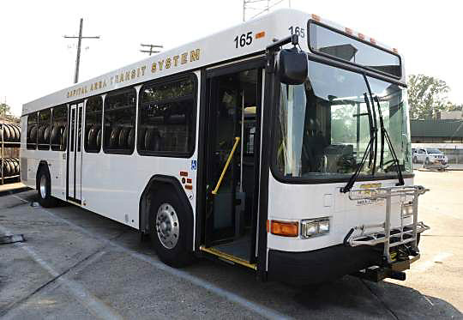
Regional resiliency in practice
Able to reach out to vulnerable populations
Launched transportation needs survey working with regional transit provider, FEMA, DOT, GOHSEP, DOTD
Identify and assist citizens who lost vehicles in the storm who still had transportation issues
NADO: Planning for a More Resilient Future: A Guide to Regional Approaches
Notes:
Nov. (3 months post storm)
Critical issue to address families living in TSAs

Slide 20
Regional resiliency in practice
Provide additional staff capacity
Lifted the issues of local elected officials up to FEMA / State during weekly briefings
Provided technical assistance for EDA and EPA grant applications in the most heavily impacted communities.
Provided GIS spatial and data analysis to local communities as they were assessing disaster impacts
Regional disaster recovery managers funded by EDA and LA Office of Community Development
NADO: Planning for a More Resilient Future: A Guide to Regional Approaches

Slide 21
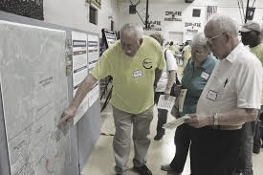
Lessons learned
Amend CEDS to reflect the work that was done over the last year with a broader understanding of regional resiliency needs and disaster response
It’s ok to advocate for the needs of the region among state and federal partners
Business continuity planning would help build regional resiliency
Watershed planning can be a springboard to a broader dialogue about regional issues and will build resiliency
Continue dialogue with federal and state partners to bring opportunities to local partners
Planning commissions are “trusted agents” for the elected officials in our regions

