Slide 1


Managing Information in the Digital World
...Cloud Computing For Local Government
Dale Graver, VC3
July, 2017

Slide 2
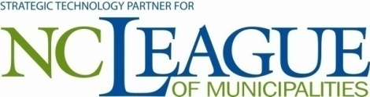

Background
Extensive Local Government IT Experience
Relationships with >160 COGs, municipalities, counties, etc.
Focused on small and medium local government
Over 20 years experience
Broad suite of technology solutions
95+ employees
Endorsed Technology Partners
Notes:
Have this slide up on the screen until we are ready to start the presentation.

Slide 3











Active In Local Government Associations
Solutions Designed Specifically For Local Government

Slide 4
Expertise with COGs in the Cloud
Partial List
Land of Sky Regional Council, NC
Lee-Russell Council of Governments, AL
Triangle J Council of Governments, NC
Three Rivers Regional Commission, GA
Kerr Tar Council of Governments, NC
Upper Savannah Council of Governments, SC
Eastern Carolina Council of Governments, NC
George Washington Regional Commission, VA
Mid-East Commission, NC
Lower Savannah Council of Governments, SC
North Carolina League of Municipalities
Municipal Association of South Carolina
Vermont League of Cites and Towns

Slide 5
Topics
Cloud Computing For Local Government
What’s driving your technology needs?
Factors to consider
When is cloud computing right for you?
What does cloud computing for local government look like?
Who’s doing it and why?

Slide 6

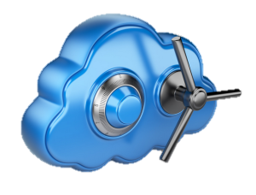


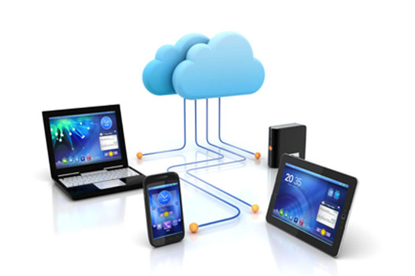
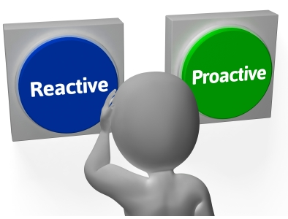
What’s Driving Your IT Needs?
Member and Staff Needs
Security
Business Continuity
Storage
Mobility
Availability
…7x24 access to services, any time…from anywhere

Slide 7


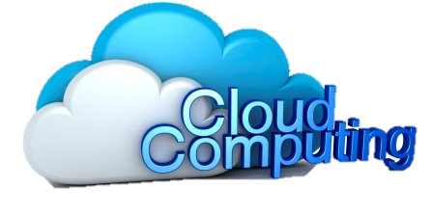



IT Continuum Stages…
Where is your organization… where are you going, and when?
Reactive
Proactive
Internal Staff
Local IT Vendor
Managed Services
“Wearing Many Hats”
Early Stages of Complexity
High Complexity
Many Technologies
Delivery of Many Services
High Availability Required
IT Complexity
Staff - Member Request for Services
Premise Based
Cloud Based
Time

Slide 8
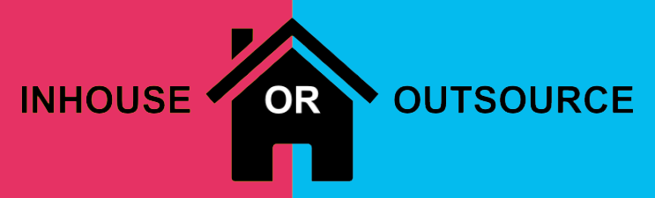
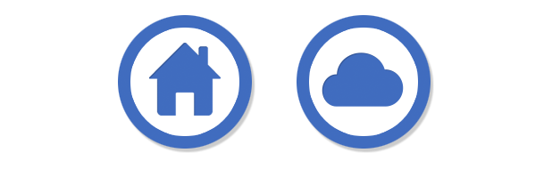
Factors To Consider
In-house vs. Outsourced
Reactive vs. Proactive
Premise vs. Cloud

Slide 9

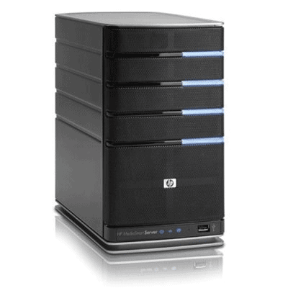
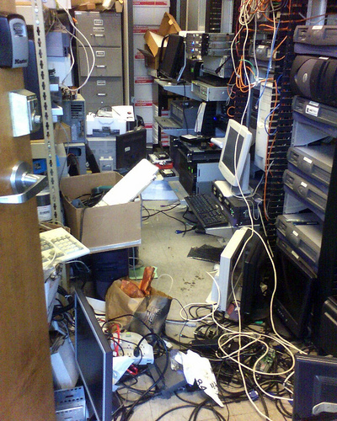
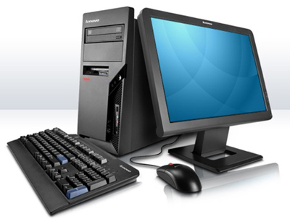
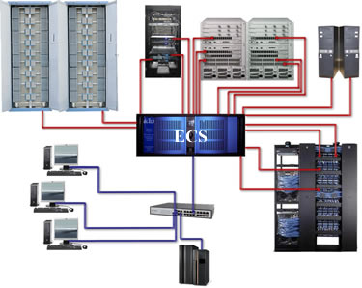
Insourced vs. Outsourced
Skill Level
Backups and Security
Budget
Retention risk
IT director skills
7x24 support availability
Variable vs. fixed costs

Slide 10



The Sky Is Falling!
Reactive
Proactive
Wait until it breaks…then fix it!
No time for root cause analysis
Early alert to problems before they happen!
Saves $$$
Improves up-time
“Break-Fix”
Managed Services

Slide 11
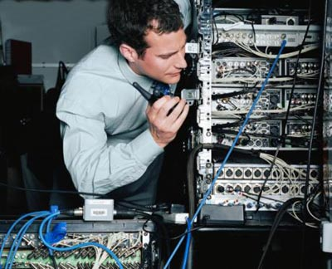
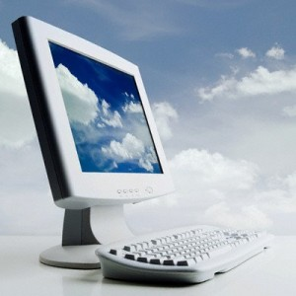
Delivery Models
Premise
Cloud
Hybrid
  Some components in the cloud
  Some components continue to be premise based

Slide 12
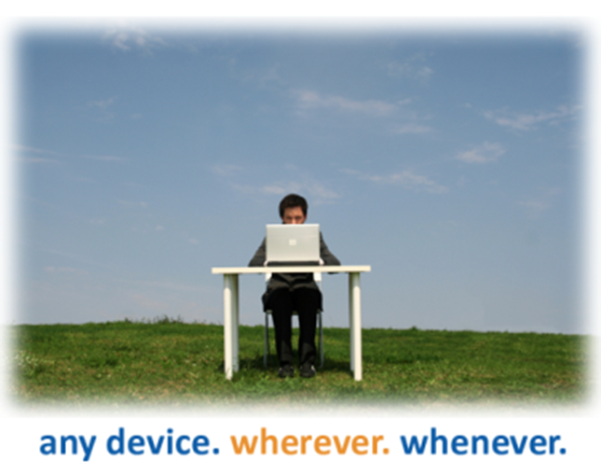
Cloud Computing for Local Government
What is Cloud Computing?
What is the right solution for Local Government?
When is the right time to adopt?
How can this be a huge enabler for:
  Your organization
  Your members
Notes:
12

Slide 13

When is Cloud Computing Right for You?
Is the breath and depth of your IT support insufficient?
Are you unable to tackle strategic IT issues because you spend all your time on tactical problems?
Are you faced with reoccurring significant desktop and server capital expenses?
Do you need increased mobility for your staff?
Is your data stored in an off-site location?
Are you worried about the viability of your business if disaster strikes?
Do you just want to get out of the day-to-day IT business and focus on your core competency?
            Stay Tuned…

Slide 14
Common Premise Based IT Environment
Expensive in time and resources to install and maintain!
3 - 4 year refresh cycle for PCs
4 – 5 year refresh cycle servers
Reoccurring software license fees
Insufficient skill level of IT staff
Lacks adequate backups & security
Slow restoral of critical business
processes after a disaster

Slide 15
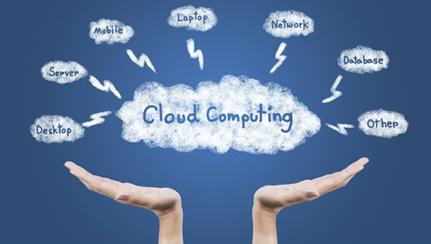
How does it work?
There is Cloud...and then there is Cloud!
Notes:
Today I will talk to you about the advantages of cloud computing and why organizations of all sizes should evaluate going to cloud when looking at upgrading their IT needs.
Cloud Computing – the practice of using a network of remote servers hosted on the Internet to store, manage, and process data, rather than a local server or a personal computer. But what does all of that really mean?

Slide 16
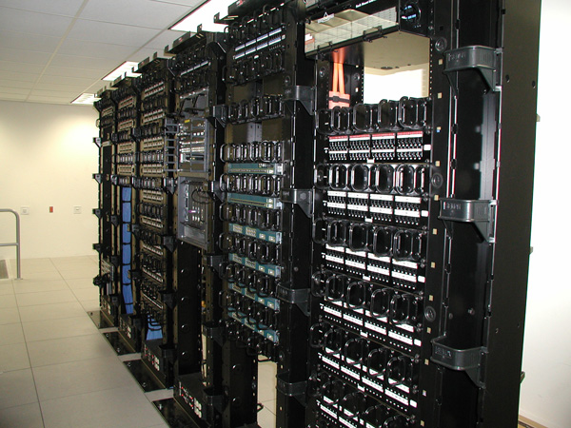
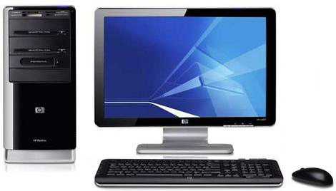
A New IT Solution Option to Consider
Premise Based IT Solution
Enterprise Class Data Center
WAN/LAN

Slide 17

A New IT Solution Option to Consider
Hosted IT Solution
Enterprise Class Data Center
WAN/LAN

Slide 18
A New IT Solution Option to Consider
Hosted IT Solution
Enterprise Class Data Center
Pixel Changes
000
Keyboard Strokes
000
WAN/LAN
Mouse Movements

Slide 19
Delivery Models
Premise
Cloud
Hybrid
  Some components in the cloud
  Some components continue to be premise based

Slide 20
Delivery Model - Premise
You buy servers
You buy desktops
You buy storage &
back-up systems
You buy all network
equipment
You pay someone to
maintain and support it

Slide 21
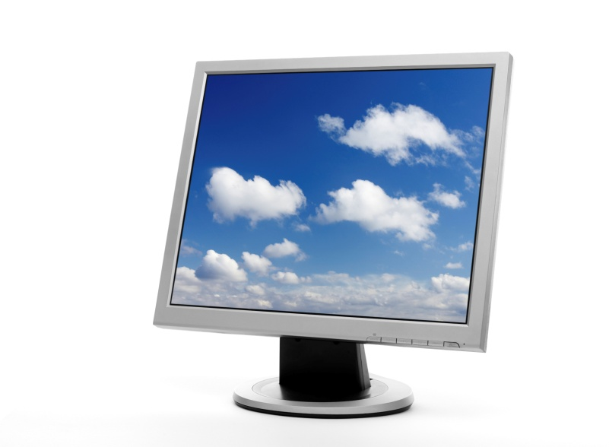
Delivery Model - Cloud
Partner provides the servers
Partner provides the desktop devices
Partner provides the storage
Partner provides the file backup, and disaster recovery
Partner maintains your environment 24x7
You only pay for what you need
Little to no up-front capital cost
Scale up/down much more quickly

Slide 22







Cloud Desktop Components:
Applications
Storage
Backups
Support
Hardware
Reports and Documents

Slide 23
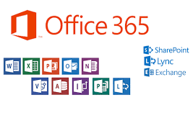




What’s Included?
Standard Applications
Microsoft Windows 7
Microsoft Office 365 E3
  Current versions of Word, Excel,
  PowerPoint, Outlook, and more
Microsoft Exchange Email
Client Applications
Host your existing applications
  Finance, GIS, Utilities, etc.
Third party vendor coordination

Slide 24
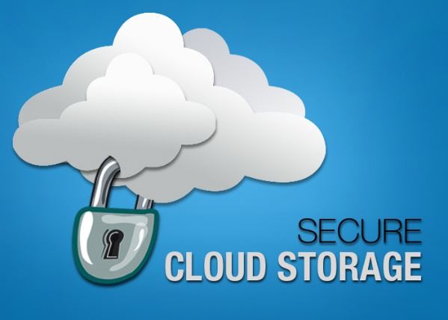
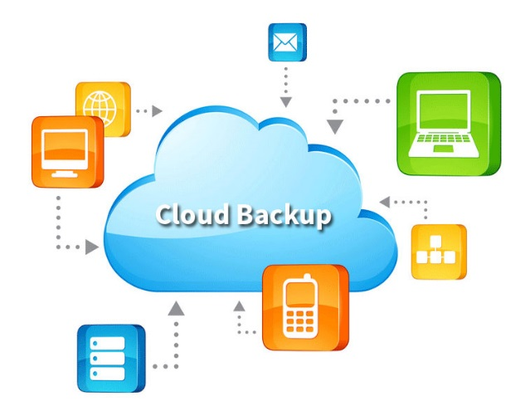
What’s Included?
Storage
Individual and shared file storage
  50G email storage per user
  10 GB VOA storage per user
  1 TB OneDrive storage per user
1 TB shared files
Backups
Nightly backup to alternate data centers
Backup retention for minimum of 30 days
Optional 10 year email auto-archive for
public records retention

Slide 25



What’s Included?
Security
SPAM filtering
Anti-Virus
Optional web filter & URL blocking
Support
7x24 Service Desk
7x24 Proactive and Reactive
Remote and Onsite Support
Software application support
Third Party Vendor Coordination

Slide 26
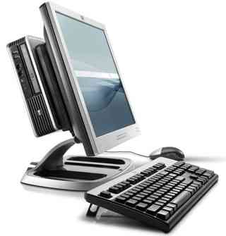
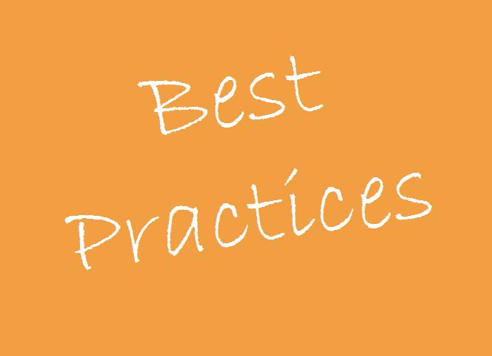
What’s Included?
Hardware
PC, keyboard,
mouse and monitor
IT Director Services
Budgeting
Strategic Planning
IT Documentation
IT Performance Report
Best Practices and Policies Library

Slide 27
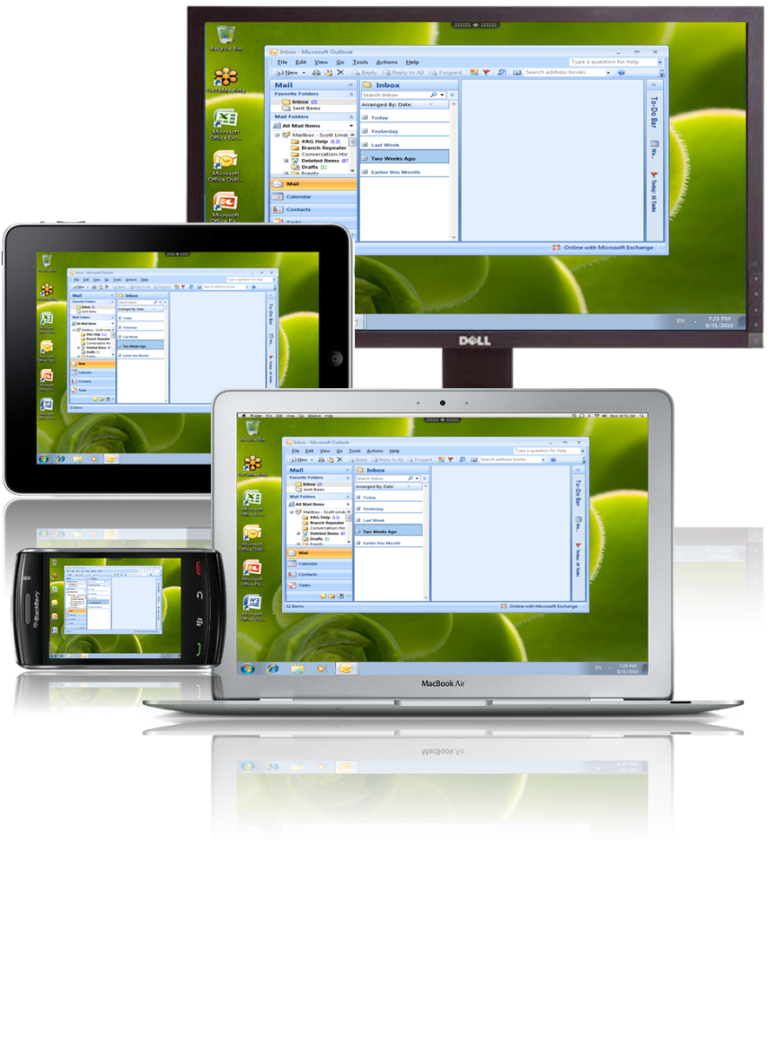
Why Cloud Based Desktop?
Never purchase a PC or server again
Cloud desktop access to all your apps
from ANY device from ANY location
Utilize more reliable and
powerful computers
Eliminate unplanned technology expenses
Built-in disaster recovery and business continuity
Focus on core competency…not IT infrastructure!

Slide 28



What’s Coming Next?
Cloud Services Broker – Managing multiple clouds!
SaaS
End Users
PaaS
Cloud Services Broker
Aggregation
Integration
Customization
Management
Arbitrage
IaaS
Vendor
Technology Partner
Vendor
Premise Based Solutions

Slide 29
Partial List of Municipal Clients in the Cloud
Over 160 Local Government Clients
Decatur, GA
Clayton, NC
Valdosta, GA
Hendersonville, NC
Burlington, VT
Ulster County, NY
Springfield, TN
Boiling Spring Lakes, NC
Bolder City, NV
Milton, GA
Sumter, SC
Waynesville, NC
Florence, SC
Emerald Isle, NC
Knightdale, NC
City of Lancaster, SC
South Hill, VA
Hiram, GA
Mauldin, SC
Powder Springs, GA
Chamblee, GA
Covington PD, GA
Benson, NC
River Bend, NC
Whiteville, NC
Winterville, NC
Belmont, NC

Slide 30

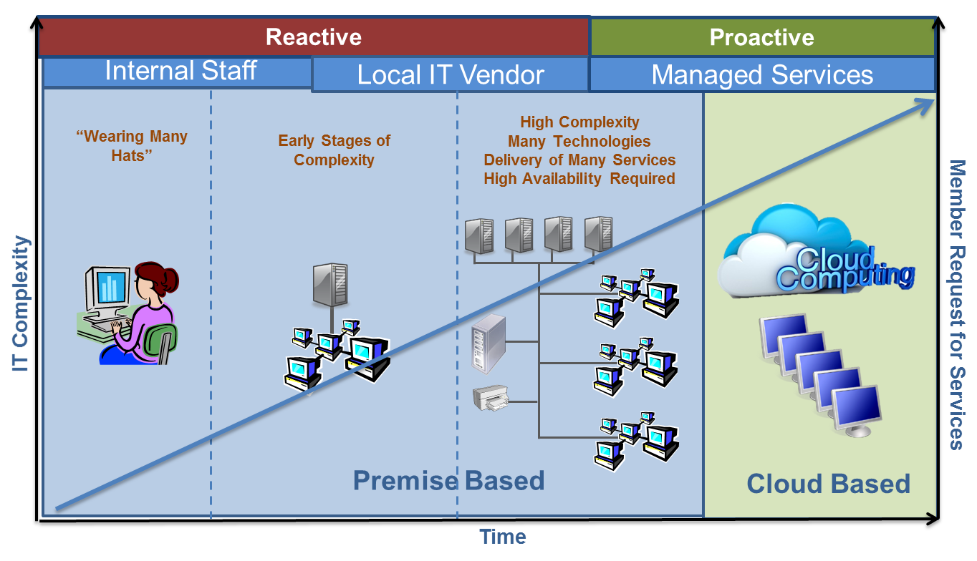
Your Homework
Do you have a plan and a partner!
Where is your organization on the IT Continuum?
Does your current IT meet the needs of the organization?
Do you have a strategic plan to transition
to the next IT stage?
Notes:
Http://canyourcloud.com/cloudsolutions/cloud-solutions-101/

Slide 31
Thank You!
Dale Graver
VC3, Inc.

