Slide 1
Austin Regional Office
State of the Region 2017

Slide 2
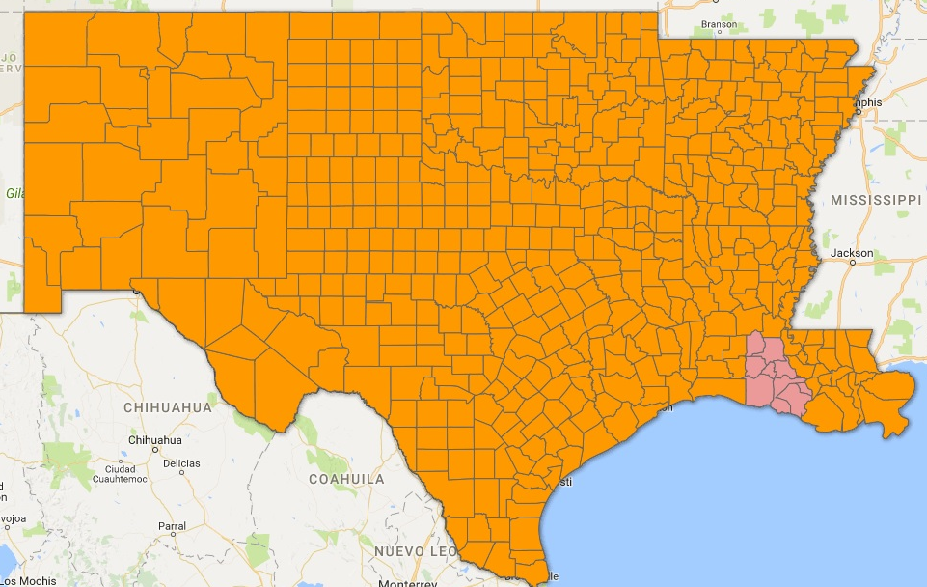
Economic development district partners
NCTXEDD designated Jan 3, 2017
APC will be designated by Sep 30th
All 59 EDDs now funded at $70k/year

Slide 3
Emerging Leaders Training
2017 Class
Beth Correa
Economic Development Regional Planner
Central Texas COG
Dustin Meyer
Local Government Services Coordinator
Panhandle Regional Planning Commission
Gloria Vasquez
Regional Services Director
Alamo Area COG
Ashley Garris
Economic Development Administrator
Western Arkansas PDD
Cheri Soileau
Executive Director
Imperial Calcasieu
Regional Planning & Development Commission

Slide 4
CNCS Vista Program
Returning as 2nd Yr Hosts:
Alamo Area COG
ArkTex COG
SPAG
VISTA Leader host:
Texas Association of Regional Councils (TARC)
New VISTA Hosts:
East Arkansas PDD
LRGVCOG
NCNMEDD
NWAEDD
STDC
WAPDD – SWAPDD
Acadiana PC

Slide 5
Economic development Integration Events
EDD Information Resource Event - one day gatherings to bring together local leaders with Federal and other funding resources in an environment that provides direct and personal contact between all. The primary goal is to establish the EDD as the information resource in their respective service areas for economic development.
Lower Rio Grande Valley Development Council – Jun 21
Coastal Bend Council of Governments – Aug 2

Slide 6
AURO 2016 funding
PW/EA Results:
4600 Jobs Created/Saved
$250 M in Private Investment

Slide 7
AURO 2017 funding & Status
$22M of Funds are Obligated
PW/EA Results:
5056 Jobs Created/Saved
$109.3M in Private Investment

