Slide 1
WELCOME

Slide 2
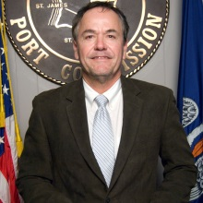
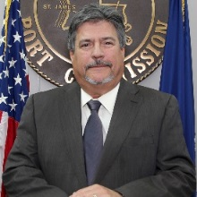
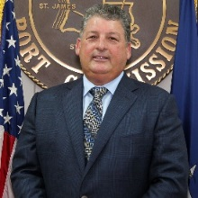
Commissioners
D. Paul Robichaux
president
Joseph M.
Scontrino III
executive vp
P. Joey Murray III treasurer
Stanley
Bazile
secretary
Robert “Poncho” Roussel vice president
Kelly
Buckwalter
vice president
Patrick C.
Sellars
vice president
Judy
Songy
vice president
Whitney
Hickerson
vice president

Slide 3
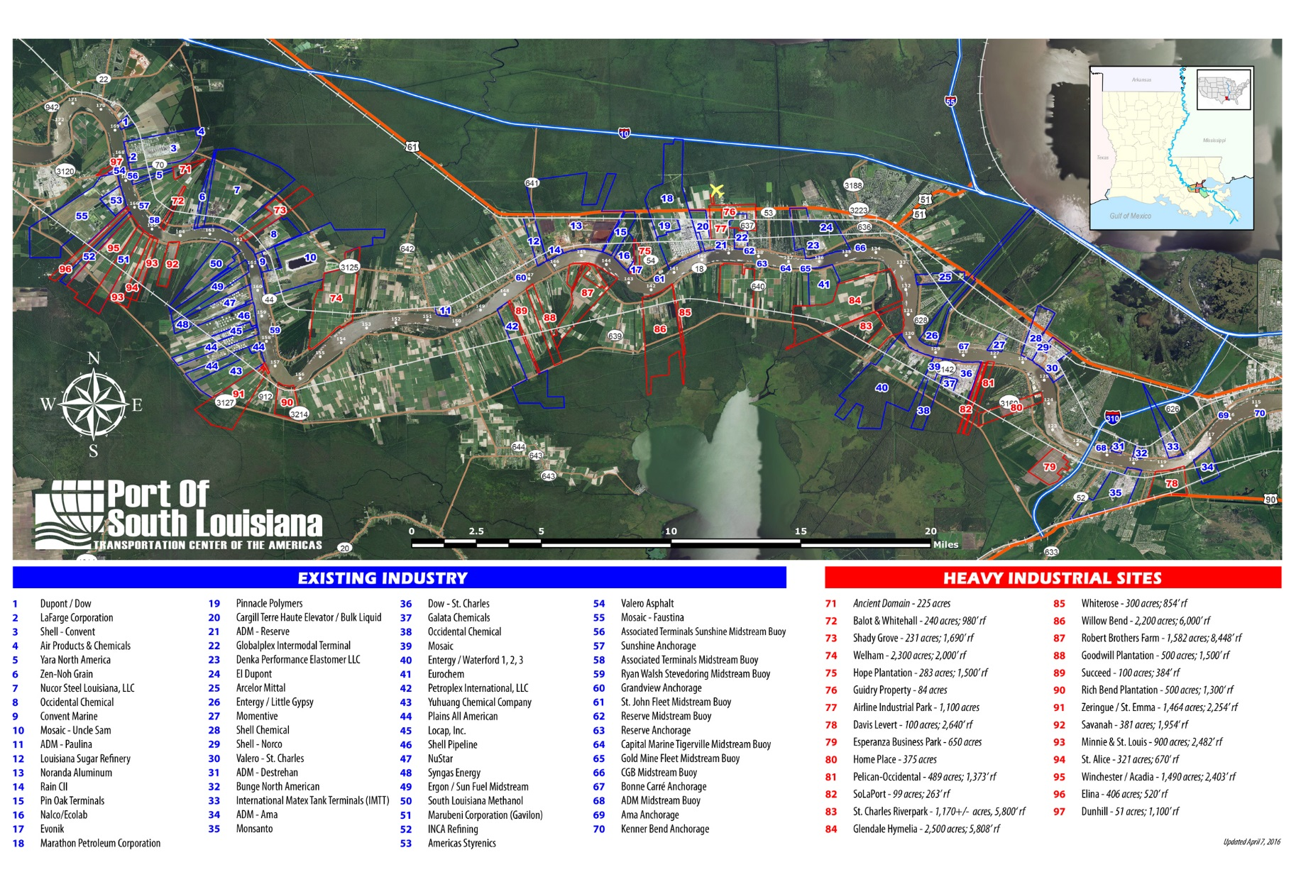
Jurisdiction
Pipelines
33 Crude
159 NG

Slide 4
Petrochemical, Chemical & Fertilizer Facilities
Air Products
Galata Chemicals
American Styrenics
Occidental Chemical
Rain CII
Denka
Monsanto
Air Liquide
Dow St. Charles
Nalco
Evonik
Mosaic
Pinnacle Polymers
Momentive

Slide 5
Oil and Grain Facilities
Oil Refineries
Shell - Convent
Marathon Petroleum
Shell - Norco
Valero – St. Charles
Grain Elevators
Zen-Noh Grain
Cargill
Bunge North American
ADM – Paulina
ADM – Reserve
ADM – Destrehan
ADM - Ama

Slide 6
Globalplex Intermodal Terminal
tenants
Evonik
NATCO Food Service
Barton Mines
Baumer Foods
Associated Terminals
LaFargeHolcim
ADM
CRC
Pinnacle Polymers
335-Acres: bulk cargo dock; general cargo dock with adjacent finger pier; over 716,000 sq.ft. covered storage; 177,000 sq.ft. open storage; 130-acre certified available site
Stevedore: Associated Terminals (committed in providing consistent, high quality, customized services for both import and export of commodities)

Slide 7
Port of South Louisiana is ranked as the #1
Largest Tonnage Port in the Western Hemisphere!
294 million short tons | 4,578 vessels | 59,780 barges (2016)

Slide 8
Port of South Louisiana is ranked as the #1
Grain exporter in the united states!
Seven grain elevators - ship to over 90 countries

Slide 9
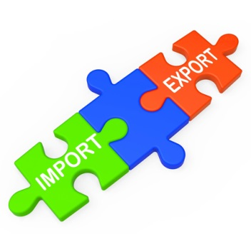
Port of South Louisiana is ranked as the #1
Foreign trade zone (#124) in the u.S. for merchandise received!
16 zones | $82 billion received & 10,500 employed (2015)

Slide 10
Port of South Louisiana Is Ranked As One of the Top…
…Energy transfer portS in the united states!
4 major oil refineries | 7 crude oil storage terminals
Pipelines: 33 crude; 159 natural gas

Slide 11
Energy Transfer Pipelines
Dakota access TO bayou bridge

Slide 12
Energy Transfer Pipelines
bayou bridge

Slide 13
Largest Tonnage Port in the Western Hemisphere
over 294 million short tons transported via, on over
4,500 vessels and 59,700 barges
largest grain port in the u.s. (50% of all the nation’s exports)
seven grain elevators
value:
over $57 billion in exports
over $26 billion in imports
one of the top energy transfer ports in the u.s.
four major oil refineries & seven crude oil storage terminals
over 40 liquid and dry bulk terminals
foreign trade zone #124 ranked first in the u.s.
*Received 82 billion in merchandise (2015)
*16 zones

Slide 14
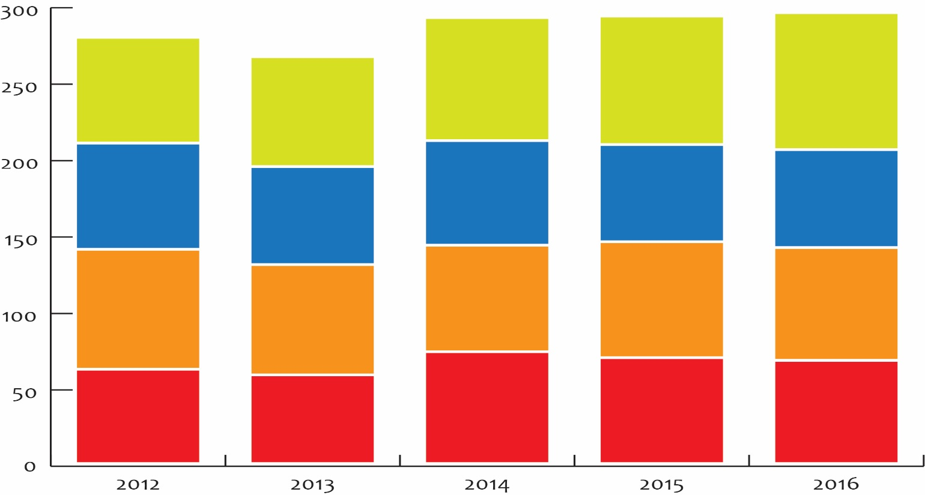
Port Tonnage
exports
imports
domestic shipped
domestic received
291.8
292.8
294.9
278.9
Total Throughput
in million short tons
266.3
69.2
80.5
84.0
89.6
71.9
69.5
68.4
63.5
64.1
64.1
78.5
69.7
75.9
73.7
72.2
61.7
58.0
73.2
69.3
67.6

Slide 15
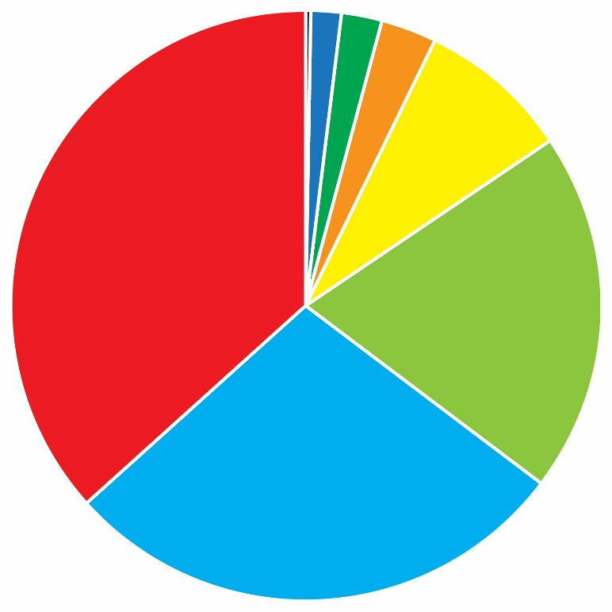
Commodities/Port Tonnage
Grain
Soybean | 47.6
Maize | 44.3
Animal Feed | 11.6
Wheat | 2.3
Sorghum + Rice | 1.9
Chemicals/Fertilizers | 24.8 | (8%)
Ores/Phosphate Rock | 8.6 | (3%)
Coal/Lignite/Coke | 7.1 | (2%)
Steel Products | 4.5 | (2%)
Other | 1.3 | (<1%)
Edible Oils | 0.8
Miscellaneous | 0.3
Concrete/Stone | 0.1
Sugar/Molasses | 0.05
2016 Tonnage:
294.9 million short tons
# Vessels: 4,578
# Barges: 59,780
Grain
107.6 (36%)
Petrochemicals
58.4 (20%)
Crude Oil
82.6 (28%)

Slide 16
Economic Impact of the Port of South Louisiana
 | regional |  | louisiana
New Business Sales | $ 14.4 billion |  | $ 19.9 billion
Earnings | $ 1.8 billion |  | $ 4.4 billion
Employment | 30,180 jobs (6 in 10 jobs in the River Region) |  | 83,409 (1 in 25 jobs in Louisiana)
# Jobs at Globalplex = 315
Tax Revenue |  | $ 72.5 million | $ 310.5 million
 |  | Loren C. Scott & Associates, Inc., 2015

Slide 17
Inland River System
CHICAGO, IL
Pop. 9,580,567
River mile 1284
Access to over
26 Million
people
in 31 U.S. States
MINNEAPOLIS/ST. PAUL, MN
Pop. 3,269,814
River mile 1791
PITTSBURGH, PA
Pop. 2,354,957
River mile 1934
ST. LOUIS, MO
Pop. 2,828,990
River mile 1148
Alabama
Arkansas
Colorado
Georgia
Idaho
Illinois
Indiana
Iowa
Kansas
Kentucky
Louisiana
Michigan
Minnesota
Mississippi
Missouri
Montana
Nebraska
New Mexico
New York
N. Carolina
N. Dakota
Ohio
Oklahoma
Pennsylvania
S. Dakota
Tennessee
Texas
Virginia
W. Virginia
Wisconsin
Wyoming
KANSAS CITY, MO
Pop. 2,067,585
River mile 1318
CINCINNATI, OH
Pop. 2,171,896
River mile 1464
MEMPHIS, TN
Pop. 1,304,926
River mile 734
LOUISVILLE, KY
Pop. 1,258,577
River mile 1330
PORT OF SOUTH LOUISIANA
River mile 114.9-168.5
NEW ORLEANS, LA
Pop. 1,170,000
River mile 95

Slide 18
Port Benefits
industrial revenue bond financing
Authority to issue taxable and tax-exempt bonds to assist industrial facilities locating within our Port district
Foreign trade zone (ftz) #124
Operator of the most active trade zone in America
Professional location assistance
Available to companies planning to locate to the river region. Includes the use of in-house GIS
maritime security and Fire protection
Round-the-clock dock security and emergency response division, in cooperation with local sheriff’s departments, with an array of firefighting and safety equipment

Slide 19
Economic Development
 | Parish | Capital Investment | # Direct Jobs | Avg Salary
Nucor Steel – U.S. | St. James | $ 3.4 billion | 1,250 | $ 75K
Yuhuang Chemical – China (methanol) | St. James | $ 1.85 billion | 400 | $ 85K
EuroChem – Russia (fertilizer) | St. John | $ 1.5 billion | 200 | $ 58K
South Louisiana Methanol – U.S./New Zealand | St. James | $ 3.3 billion | 63 | $ 66K
Monsanto Expansion – U.S. | St. Charles | $ 975 million | 95 | $ 76K
Entergy | Little Gypsy Expansion – U.S. | St. Charles | $ 869 million | 27
. . . . . . . . . . . . . . . .

Slide 20
Economic Development
 | Parish | Capital Investment | # Direct Jobs | Avg Salary
Pin Oak Terminals – U.S. (crude oil) | St. John | $ 750 million | 80 - 100 | $ 63K
NuStar – U.S. (crude oil tank storage) | St. James | $ 365 million | 32 | $98K
Syngas Energy - Malaysia (methanol) | St. James | $ 360 million | 86 | $ 78K
Marubeni Corporation (Gavilon Trading) - Japan (grain) | St. James | $ 250 million | 100
BioAmber - Canada (proppants) | St. John | $ 200 million | 100 | $ 70K
Bunge North America expansion – U.S. (grain) | St. Charles | $ 140 million
. . . . . . . . . . . . . . . .

Slide 21
Economic Development
 | Parish | Capital Investment | # Direct Jobs | Avg Salary
Plains All American – U.S. | St. James | $ 50 million
Momentive Specialty Chemicals – U.S. | St. Charles | $ 38 million | 8 | $ 82K
Kongsberg Maritime – Norway (office & training) | St. Charles | $ 15 million | 200 | $ 100K
Denka Performance Elastomers – Japan (Corporate Headquarters) | St. John |  | 16 (corporate) | $ 80K
Formosa Petrochemical Corporation – Taiwan (industrial complex feasibility study) | St. James | $ 9.4 billion | 1,200 | $ 84.5K
Announced Future Projects: $23.462 billion capital investment and, at least, 3,857 direct jobs

Slide 22
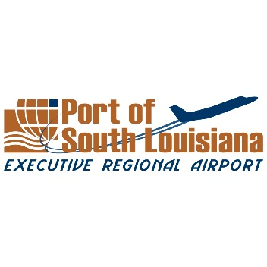
Port of South Louisiana Executive Regional Airport
5,100’ x 75’ Runway
FAA AWOS
Jet-A & AvGas Fuel
FBO Services
10K sq. ft. hangar (available soon)
Video Surveillance
Secured Aircraft Parking

Slide 23
PSL Consultants
AUX INITIATIVES General Robert Crear
ADAMS & REESE Jeff Brooks
JAMES PURPERA GOVERNMENTAL CONSULTING James Purpera capital outlay specialist
TJC GROUP Tim Johnson public affairs/community outreach governmental relations workforce development
TOP DRAWER/FOCUS STRATEGIES Mary Patricia Wray LaurayVeazey

Slide 26
Expanding Your Business Globally
Export-Import Bank of the United States
www.exim.gov
World Trade Center of New Orleans
www.wtcno.org

Slide 27
…important to our community …important to our state …important to our country

Slide 28
…important to the world!

Slide 29
Support your port!
THANK YOU

